Slide 1


HomeCredit Analysis
By Lindsey Ahlander, Ashley Goldstein, Kyle Aagard, Eliza Baier
Notes:
Hello, and welcome to our HomeCredit Analysis presentation. I’m Ashley, and I’m joined by Eliza, Lindsey, and Kyle. We’re excited to show you how our model is helping to address servicing the unbanked population without sacrificing lender security.
We will walk you through how we built, tested, and validated our model. You’ll see how it outperforms the baseline, and how we plan to deploy and monitor its performance in real-world lending scenarios. Our hope is that this approach not only drives growth for HomeCredit, but also helps individuals access the capital they need to thrive.
Thank you for being here, I’ll now hand it over to Eliza to talk about the business problem.

Slide 2
01
Business Problem
Notes:
Introduce business problem and its value to the firm

Slide 3

Unbanked population
Insufficient credit history
Understand default
Predict default risk
Notes:
Thank you Ashley! In the Philippines, one of Home Credit’s major operating countries, 34.3 million or 44% of total adult population are unbanked. An even higher percentage have insufficient credit history. These two populations face significant challenges when it comes to finding a safe lending experience as their lack of credit history leaves them vulnerable to loan sharks and other irreputable loan sources. The focus of this project is to assist Home Credit in their goal of providing a safe lending experience to this unbanked and undercredited population.
To accomplish this goal, we focused on two major aspects of the lending process - understanding default and predicting default risk. As a result, we were able to better understand the factors that influence repayment and build a model that accurately predicts credit default in a vast majority of cases. This model is one that Home Credit can use to provide a safe lending experience to the unbanked and undercredited population they aim to serve. I’ll now turn it over to Lindsey to talk about the key takeaways.

Slide 4
02
Key Takeaways
Notes:
Thanks Eliza!
The challenge here is striking the right balance: growing the customer base while continuing to lend responsibly and minimize exposure to unnecessary financial risk.
That’s where our predictive model comes in. It’s designed to identify new, creditworthy applicants who might be overlooked by traditional scoring methods.

Slide 5
29%
$61 million
Notes:
With this model, HomeCredit could increase security against default by 29%. And that improvement isn’t just a performance stat—it represents a tangible opportunity for business impact. That boost in risk mitigation could drive an estimated $61 million in additional revenue.

Slide 6
Expanded customer population
Empower underserved communities
Notes:
Bottom line? Our model expands access to credit in a way that’s smart, strategic, and aligned with HomeCredit’s mission to empower underserved communities by extending financing options to the unbanked population.
Now I’ll hand it over to Kyle to talk more about our model.

Slide 7
03
Modeling

Slide 8
Application Data
Bureau Data
Notes:
-Thank you Lindsey.
-Home Credit’s current application data captures a wide variety of information about potential customers, including up to 3 different external credit scores. Many potential customers had only 2 or less of these scores. The credit scores are of course strong predictors as to whether a customer will default or not. However, it limits home credit from reaching populations who may understand how credit works, or are younger and have not been able to establish sufficient credit scores.
-To bridge this knowledge gap, we decided to incorporate the Bureau data into our new model. This was a much larger data set that captured the the customers transactional behaviour, rather than the information filled out on a single application.
-This yielded some important insights.

Slide 9
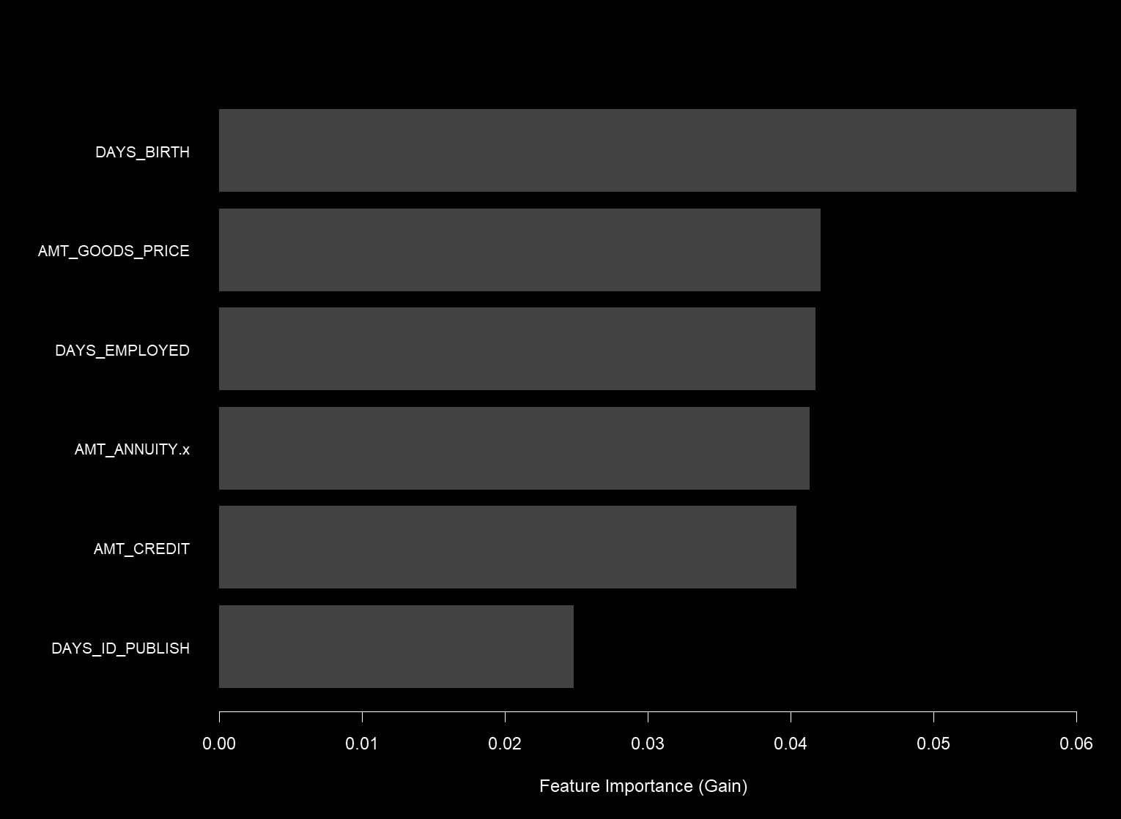
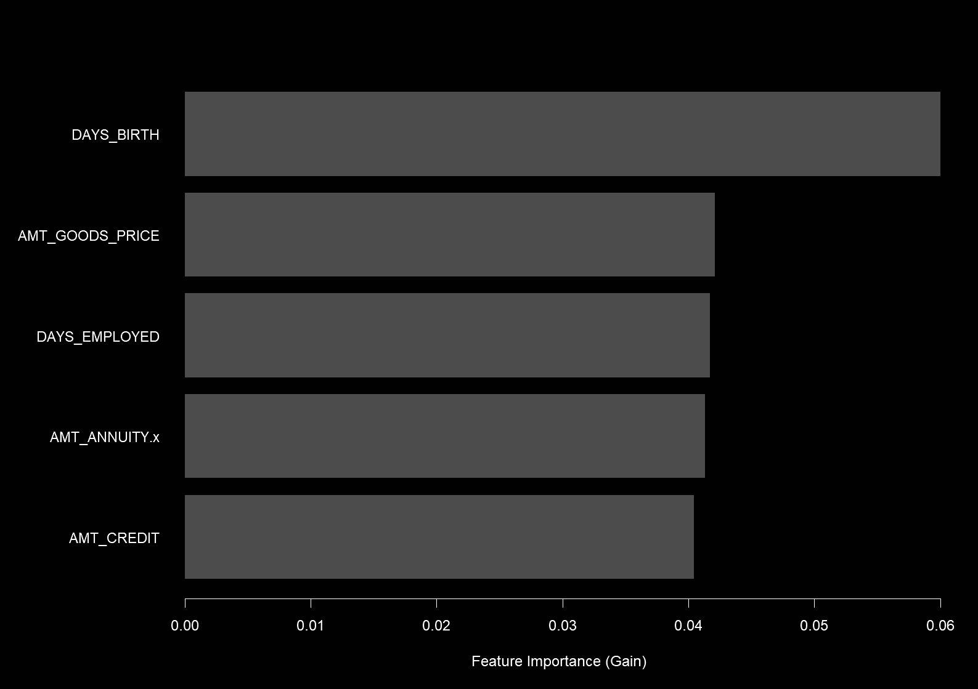
Notes:
-This slide contains several of the top 15 features that our model relied upon to make its predictions. While credit scores were still a factor, as you can see our model does not just rely upon them.
-The AMT_ANNUITY column is one of the new factors from the bureau data that our model relied upon to make its predictions.

Slide 10
+29%
Positive Prediction Rate:
Baseline = 47%
Our Model = 62%
Notes:
-We measured our models’ performance by its’ ability to positively predict who will default and who will not. This is represented by the positive prediction rate shown in the upper left hand corner.
-As a baseline model we used only the data provided in Homecredit’s application data set.
-Our new model model incorporated the bureau data we discussed earlier.
-As a result our model was able increase the security against default by 29.2%.

Slide 11
04
Business Implication
Notes:
We understand that was a lot of technical jargon, so what does that mean for HomeCredit.

Slide 12

Predict loan risk
Improve lending experience
Notes:
By creating a reliable model to forecast customer repayment, we can make predicting loan risk more secure as well as expand banking services to those outside of conventional institutions.

Slide 13
13.6% lending population
Notes:
This can help responsibly extend credit to an additional 13.6% of potential customers who might otherwise be turned away. Providing a non-predatory loan experience with this population will help to encourage even more expansion among their social circles.

Slide 14
29%
$61 million
Notes:
As Lindsey said previously, with a 29% increase in predictive power, we can draw in an additional $61 million in revenue for HomeCredit. The business implication is clear: an expanded customer base, increased revenue opportunity, and importantly, the ability to foster financial inclusion among those who have historically been denied credit. I’ll hand it back to Eliza to show how we’ll move forward.
Previously 3% and 6.3 million - changed because percentage changed after calculating with 3 decimal place difference in AUC
Creating a reliable model to predict customer repayment, we can expand banking services to those outside of conventional institutions
By providing a non- predatory lending experience, we can foster loyalty from our expanded customer population.
Got to $61 million by multiplying the change in accuracy by the number of loans in a year (1.1million in 2022) by the cost of being incorrect (we estimated that to be 190, $95 annual interest * two year term) $95 annual interest was derived from HC financial disclosures.

Slide 15
05
Next Steps

Slide 16

Test with IT systems
Train loan officers
Notes:
Thank you Ashley! Finally, we wanted to talk about how to implement the model so that Home Credit can use it for its intended purpose. The first step will be to test the model with HomeCredits IT systems to make sure it can be properly and usefully deployed.
The second step will be to train the loan officers to use the system. Proper deployment will ensure that the loan officers will be able to pull the customer’s information from the loan application and from any financial institutions. Feeding this information into our model will give the loan officer a prediction of the person’s default risk, allowing them to make an informed decision whether to accept or reject the loan application. If this feels a little scary, don’t worry! We will be there every step of the way to help your loan officers understand how to effectively use the model.

Slide 17

Deploy Model
Track performance
Re-calibrate and maintain
Notes:
After deploying the model to assist HomeCredit’s loan officers in making informed decisions,
we plan to track model performance for 1 year. Tracking model performance will allow us to continue to adapt the model as new information becomes available.
We plan to re-calibrate the model quarterly, using the new data obtained from the previous quarter of approved loan applications and their results. This re-calibration and maintenance will continually improve our algorithm so that at the end of the year, HomeCredit will have an even better performing model.

Slide 18
THANK YOU!
Notes:
We are excited to implement these changes and help HomeCredit increase revenue and achieve their goal of providing a safe lending experience for the unbanked and undercredited population they aim to serve. Thank you so much for listening! Are there any questions?

Slide 19
Sources
https://www.bsp.gov.ph/Inclusive%20Finance/Financial%20Inclusion%20Reports%20and%20Publications/2021/2021FISToplineReport.pdf
https://tribune.net.ph/2024/03/17/decision-makers-in-getting-loans-are-women-home-credit?utm_source=chatgpt.com
https://www.homecredit.ph/help/cash-loan?utm_source=chatgpt.com

